Slide 1
Media Streaming With IBM Cloud Video Streaming
Objectives
Key Challenges
Conclusion

Slide 2
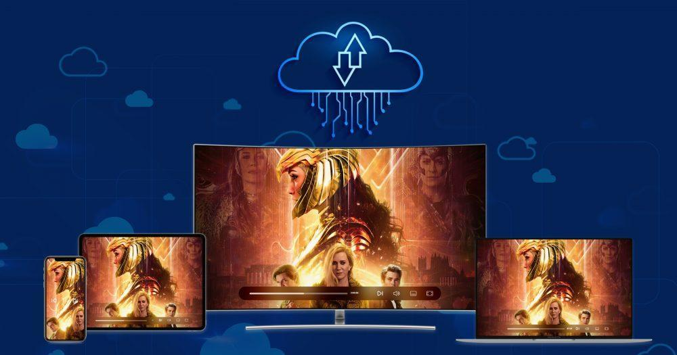
Objectives
The objective of this project is to design, develop, and deploy a media streaming solution using IBM Cloud Video Streaming services to enable seamless content delivery, live streaming, and on-demand video playback for users.

Slide 3

Key Challenges
Integration Complexity: Integrating IBM Cloud Video Streaming services into the existing infrastructure may pose technical challenges.
Scalability: Ensuring the platform can handle a growing number of concurrent users and streams
Quality of Service: Delivering high-quality video content with minimal latency and buffering.

Slide 4
Design Thinking
Designing a user interface (UI) for media streaming using IBM Cloud involves several key considerations. Here's a high-level overview of the steps and factors to keep in mind:
User Research: Understand your target audience and their preferences. What devices do they use for streaming? What features do they expect? Conduct user surveys or interviews to gather insights.
Content Organization: Create a clear and intuitive navigation structure for your media content. Use categories, filters, and search functionality to help users find what they're looking for easily.
Responsive Design: Ensure your UI is responsive, meaning it adapts to different screen sizes and orientations. Users might access your streaming service on smartphones, tablets, or computers.
Visual Design: Create an appealing and consistent visual design that aligns with your brand. Choose colors, fonts, and imagery that enhance the overall user experience.

Slide 6
Conclusion
By addressing the challenges and objectives outlined in this problem definition, the project aims to create a robust and efficient media streaming solution using IBM Cloud Video Streaming services.

